Slide 1
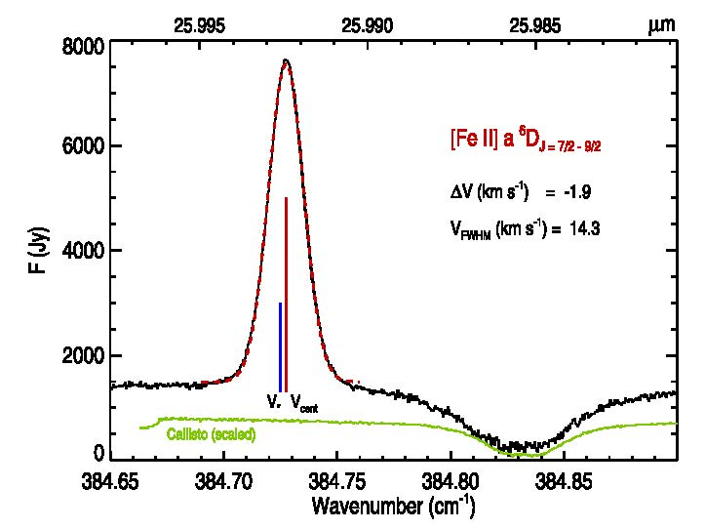

Betelgeuse High-Resolution [Fe II] Emission Data
Mid-IR Observations of [Fe II] Emission from
the Extended Atmosphere of Betelgeuse
Harper, G. M. et al., 2017, ApJ, 836, 22.
Instrument: EXES, R=55,000 at 25.99 μm
EXES [Fe II] 25.99 μm spectrum from Betelgeuse
Background
Late type supergiants experience surface winds that result in mass-loss rates of over 10^-6 M sun/yr. These winds are typically dust, and therefore thought to be driven by radiation pressure on small dust grains and/or large molecules.
However, some supergiants, such as Betelgeuse, have winds relatively devoid of dust grains, which challenges the idea that these winds are driven by radiation pressure on grains.
Understanding the nature of these winds requires models of the thermal structure of the wind from the surface of the star out to over 100 stellar radii. Observing atmospheric cooling lines is one way to constrain and check these models. [Fe II] is one of the dominant fine-structure cooling lines for a low-ionization wind flow.
blue- shifted emission is separated from the telluric contamination ~384.83 cm⁻¹
clear offset of the line center (V_{cent}) from the stellar radial velocity (V*)
Extremely high-spectral resolution data allows detection of a small velocity shift in the line profile, indicating that the emission is coming from a region closer to the star than would be predicted by previous models. I.e., the flow cools (to below 500K) much sooner than previously thought.
As higher-fidelity models for stellar winds are developed, high-spectral resolution observations of mid-IR cooling lines will continue to play an important role in constraining model parameters and improve our understand of how these stellar winds are driven.
Background Image: The Spotty Surface of Betelgeuse
Image Credit: Xavier Haubois (Observatoire de Paris) et al.

